Slide 1

ASTROSAGE ANALYSIS
SURYAKANT SINGH
18th APRIL 2025

Slide 2

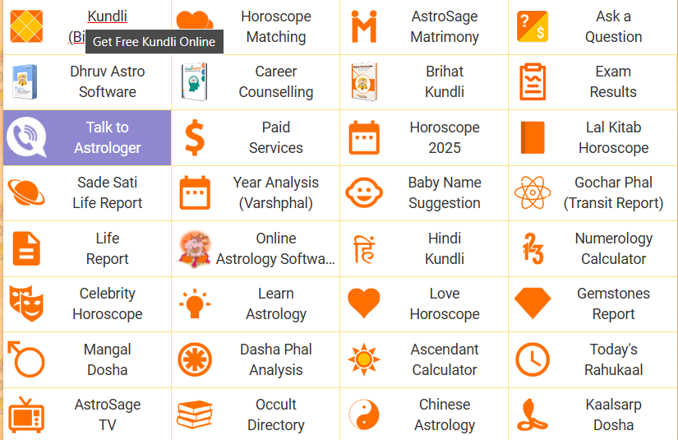
INTRODUCTION
ASTROSAGE offers an AI-powered platform that provides personalized AI horoscope readings, AI KUNDALI generation, and consultations with AI astrologers. cutting-edge AI technology analyzes vast amounts of astrological data to deliver accurate, customized predictions and insights.

Slide 3

ABOUT ASTROSAGE
🌟 Overview
A dedicated astrology-based call centre providing expert guidance
Connects customers with professional astrologers for personalized predictions
📞 Services Offered
Horoscope analysis and future predictions
Kundli matching and relationship guidance
Career, finance, and health-related consultations
💡 Why It Stands Out
24/7 accessibility for astrology queries
Experienced astrologers with diverse expertise

Slide 4

How Astrosage Call Centre Works
🔗 Customer Interaction Process
Customer calls for an astrology consultation
Assigned to an expert astrologer
Personalized analysis & predictions given
Feedback and follow-up services available
🚀 Technology & Support
AI-powered astrology insights
Secure and efficient customer management system
Multiple language support for diverse audiences

Slide 5

AIMS OF ANALYSIS
ALLOCATION OF INVESTMENT TO
OPTIMIZE THE FOLLOWING KEY METRICS:
1. Performance Evaluation
2. Customer Experience Enhancement
3. Agent Productivity & Training
4. Technology & Automation Integration
5. Cost & Resource Optimization

Slide 6

DATA OVERVIEW
1. Average calls per day approximately 250 indicating that lot of user want suggestion from ASTROSAGE through calling
There are various option by which customer customers with astrologers or astrologers interact with customers through chatting , calls , public live calling from astrologer etc.
3. Net revenue by the call center is 213987.3 rupees
Average no of agent working per day is 4
Average no. of call volume handled per agent per day is 57

Slide 7
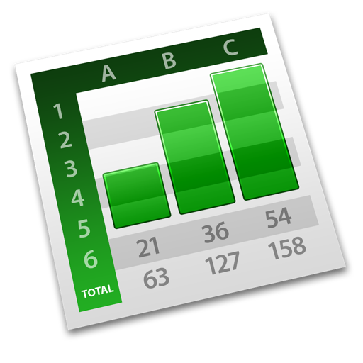
METHODOLOGY
Data cleaning: Utilized functions like remove duplicates to ensure data accuracy
Data enrichment: Enhanced the dataset with additional variables like date , month , day using TEXT function to cross reference external data sources.
Used search function like vlookup , xlookup etc.
Descriptive Analysis : Employed Pivot tables for summarizing key metrics and identifying the patterns

Slide 8
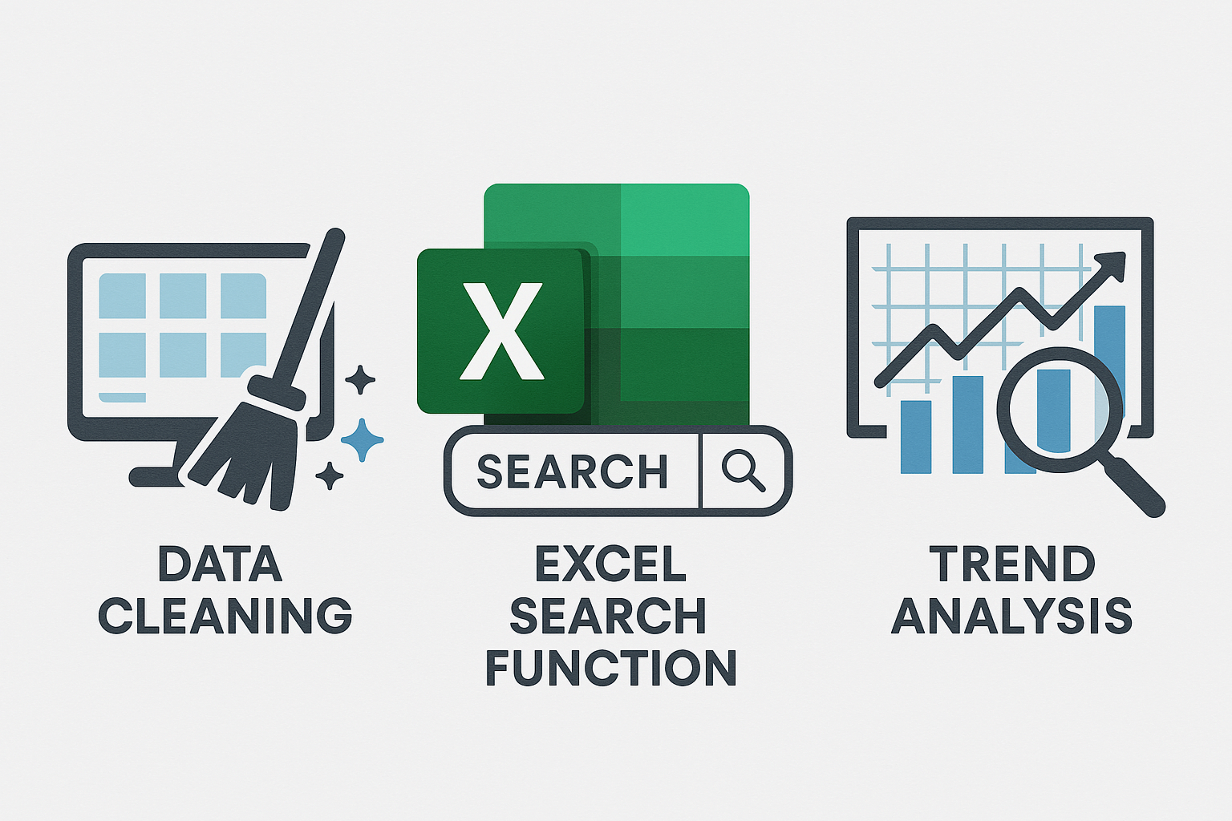
6. Trend Analysis: Conducted time series analysis using trend chart
7. Visualization: created dynamic charts and dashboards for data Representation ,enabling interactive data Exploration
8. using slicer we can see the monthly , daily trends of call volume

Slide 9
ANALYASIS
Failure rate is high (37%): Understanding why they failed—technical issues, customer dissatisfaction, or incomplete responses—could reveal valuable improvement opportunities.
Incomplete chats (34%): Investigating this further could help refine customer engagement strategies.
Completed chats (29%): What contributes to successful completions? Identifying best practices could help replicate success.
Pending and Started chats (0%): Check what is the root cause of it

Slide 10
As clearly seen through column chart december month has high average rating than January month but in both month average rate is very less in comparison 10
repeat customers (81%) form the majority of interactions in call center, while unique customers (19%) make up a smaller portion. This insight can guide strategies for improving customer service, retention, and problem resolution.
Since a large share of users are repeaters, it’s crucial to analyze why they return. Are they calling for unresolved issues, follow-ups, or loyalty-driven interactions?
Since unique callers represent 19%, understanding their needs can help convert them into loyal customers.

Slide 11
Average Calls per Day (Blue):
The largest segment, representing high daily call volume.
Average Calls per Agent per Day (Green):
Shows a significant workload per agent, but smaller compared to total daily calls.
Average Agents for Calls per Day (Red):
The smallest segment, indicating fewer agents than needed relative to the call volume.
Summary: There may be operational challenges due to fewer agents handling a large number of calls, suggesting potential workforce optimization.

Slide 12
High Completion Rate (41%): This suggests good call connectivity and engagement.
No Answer (20%): this happen may be due to the
less agent
Busy Calls (15%): this may happen due to incoming call may be in peak hour or due
Failed Calls (14%): cleaning up invalid contacts could improve productivity.
Incomplete Calls (10%): network issues or caller disengagement should be investigated.

Slide 13
Gurucool's dominance suggests that most users prefer this platform over the App and Dashboard.
Dashboard usage at 0% perhaps due to poor accessibility, lack of features, or user preference for Gurucool.
App usage at 28% indicates moderate engagement. Majorly use for calling purpose

Slide 14
Peak Call Volume: The busiest hours are between 10:00 to 18:00, peaking around 15:00, indicating when customer demand is at its highest.
Off-Peak Hours: Call volume remains low between 00:00 to 06:00, suggesting minimal customer interaction during these early morning hours.

Slide 15
Profit Trends: The net profit (represented by green bars) fluctuates across different periods, showing significant variations. The logarithmic trend line helps smooth out these fluctuations, indicating the overall trajectory.
Astrologers’ Earnings vs. Total Sales: The sum of astrologers' earnings (blue line) and the sum of total sales (red line) appear to follow a similar pattern, suggesting a correlation between astrologer revenue and total sales performance.
Potential Peak Points: Notable peaks in total sales and astrologers' earnings could indicate high-demand periods or seasonal trends that impact both revenue streams.

Slide 16
Highest Guru Concentration: The largest number of gurus fall under the 0-rating category, with maximum guru which might indicate a substantial portion of new ,unrated or untrained gurus.
Mid-Tier Ratings: Ratings 2, 3, and 4 suggests a significant portion of gurus have moderate performance or customer engagement.
Lowest Guru Count: Ratings 6, 7, and 8 have fewer gurus showing that achieving higher ratings might be more challenging.

Slide 17
pie chart shows that Calls contribute 79% of the total revenue, while Chats account for 21%. Complementary and Public Live Calls generate 0% revenue.
Key Takeaways:
Calls dominate revenue generation, making them the primary focus for optimization.
Chats hold a significant share, suggesting room for improvement or expansion.
Non-revenue categories might need reevaluation or repurposing to add value.

Slide 18
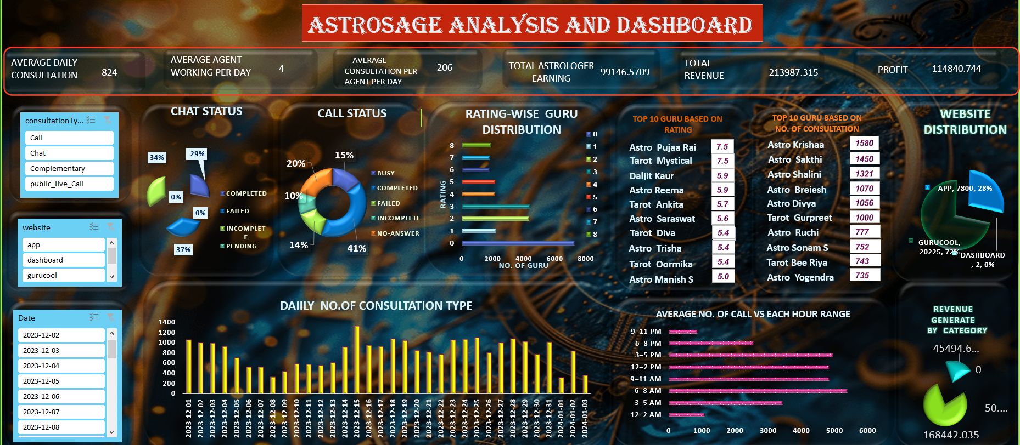

Slide 19

STRATEGIC RECOMMENDATION
Strategic Recommendations
Implement Advanced Analytics
Use AI-driven tools to analyze call data for trends, customer behavior, and agent performance.
Expected Impact: Better insights into customer
needs, enabling tailored service, which enhances
satisfaction and loyalty.
Enhance Agent Training
Focus on skills like emotional intelligence, product knowledge, and conflict resolution.
Expected Impact: Improved agent efficiency and a better overall customer experience.
Optimize Call Routing
Deploy intelligent systems to route calls to the most appropriate agent or department.
Expected Impact: Reduced wait times and higher first-call resolution rates, boosting satisfaction.

Slide 20

4.Offer Omnichannel Support
Integrate chat, email, social media, and voice into a seamless experience.
Expected Impact: Increased accessibility for customers, leading to higher engagement and retention.
5.Leverage Self-Service Options
Develop a robust FAQ system, chatbots, and automated IVR for common queries.
Expected Impact: Reduced call volumes and faster query resolution, while maintaining customer satisfaction.
6.Monitor and Reward Performance
Regularly review key performance metrics (KPIs) like average handle time and customer satisfaction scores.
Incentivize agents for achieving benchmarks.
Expected Impact: Higher employee morale and consistent performance improvements.
7.Personalize Customer Interactions
Use CRM systems to provide agents with customer history and preferences.
Expected Impact: Strengthened relationships with customers and increased loyalty.

Slide 21

CONCLUSION
In conclusion, a detailed analysis of our call center operations reveals opportunities to enhance customer satisfaction, streamline processes, and improve efficiency.
By leveraging these insights and adopting the recommended strategies, we can position our call center as a model of excellence.
Thank you for your attention, and I look forward to any questions or further discussions.

Slide 22


